Slide 1

Welcome – Virtual Housekeeping Items
Transportation Systems Management and Operations (TSMO)
If you haven’t already, please type the name and the agency you represent into the chat box. This will serve as our virtual meeting sign-in sheet.
For this presentation, please make sure that you are on mute. If you have questions as we present the slides, please type them into the chat box.
During the session we will use the chat feature to get your input as well as ask you to take yourself off mute from time to time for discussion.
DFW TSMO Program Plan
Capability Maturity Model (CMM) Assessment – Work Zone, Planned Special Event, and Road Weather Management
Turn CHAT on Here

Slide 2

Transportation Systems Management and Operations (TSMO)
DFW TSMO Program Plan
Capability Maturity Model (CMM) Assessment – Work Zone, Planned Special Event, and Road Weather Management
August 18, 2020

Slide 3
Self Introductions

Slide 4
Table of Contents
1
CMM Webinar Objectives
5
2
TSMO Capability Maturity Model Basics
6-9
3
TSMO Topic Area Overview
10-11
4
TSMO Capability Maturity Model – Strengths, Weaknesses, Actions to Improve
12-25

Slide 5
CMM Webinar Objectives
Provide Your Inputs to the Dallas/ Fort Worth District TSMO Plan
  Step through an abbreviated CMM process on a specific TSMO strategy.
  Use the “Chat” feature to discuss strengths, weaknesses, and action to advance.
Continue the Conversation
  Discuss any questions on the TSMO strategies moving into the plan development phase of work.

Slide 6
Transportation Systems Management and Operations
  Essentially, the purpose of a TSMO Program Plan in your region is to evaluate how the existing transportation network is functioning with the aim of improving operations.

Slide 7
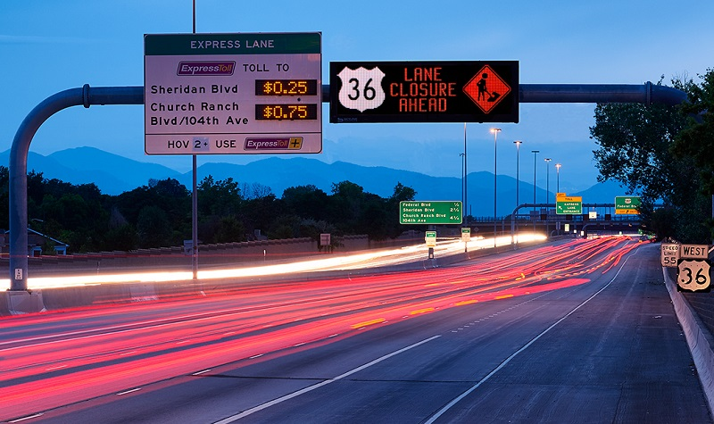
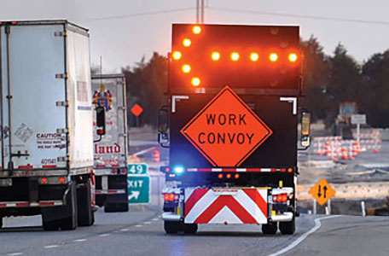

Transportation Systems Management and Operations
Traveler Information
Managed Lanes
Traffic Signal Management
Special Event Management
Road Weather Management
Freight Management
Integrated Corridor Management
Work Zone Management
Traffic Incident Management
Active Traffic Management
Notes:
This slide lists several of the operations strategies that have been applied by DOTs and transportation agencies across the country; and in doing so, they have made substantial positive impacts on the safety, mobility, and reliability of the surface transportation network.
These strategies, of which ITS and traffic signals a major part, are most effective when they are considered in early stages of the project development process, sustained over time with dedicated funding, and optimized via coordination among transportation agencies in the region.
These strategies are relatively low in cost compared with adding capacity, can be implemented in two to three years, and offer substantial benefits- for example, a benefit-cost ratio of 10:1.
Some of these strategies have already been deployed, or are currently being researched for use in various parts of the state.
Source(s): -1.) Institutional Architectures to Improve Systems Operations and Management, SHRP2 Strategic Highway Research Program, SHRP2 Reliability Research, Report S2-L06-RR-1, -2.) Investment Opportunities for Managing Transportation Performance Through Technology. Intelligent Transportation System Joint Program Office, U.S. Department of Transportation, 2009, -3.) Benefits of Using Intelligent Transportation Systems in Work Zones: A Summary Report,. FHWA,

Slide 8


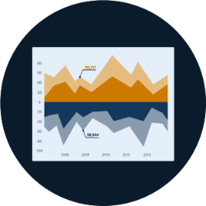



Transportation Systems Management and Operations
Capability Maturity Model
Business Processes | Systems & Technology | Performance Measures
Culture | Organization & Workforce | Collaboration
Notes:
Erin Flanigan covers this slide

Slide 9
The Dimensions of Capability Maturity
Business Processes: Planning, programming, budgeting, implementation
Systems & Technology: Systems engineering, standards, documentation
Performance Measurement: Measures, data & analytics, utilization
Culture: Technical understanding, leadership, outreach, authority
Organization/Workforce: Organization structure/ workforce capabilities
Collaboration: Partnerships - public and private
Notes:
Business processes, including formal scoping, planning, programming, and budgeting.
TSM&O needs to be integrated into the state or regional planning process, which focuses on allocating federal and state funds within the conventional construction and maintenance programs.
Systems and technology, including systems architecture, interoperability, standardization, and documentation.
State DOT technical staff needs not only a well-developed understanding of systems and technology issues, federal guidance, but also needs to focus on standardization, upgrades, and integration, especially with the rapid rate of technology development.
Performance measurement, including measures definition, data acquisition, analysis, and utilization. Improving the effectiveness of any TSM&O strategy depends on performance measurement. Some state DOTs measure their TSM&O by the amount of activities they perform, and conduct post-event debriefings after major crashes or storms but have not yet develop the measures, analytics and reporting systems for “outputs” – systems performance in customer terms
Culture, including technical understanding, leadership, policy commitment, outreach, and program authority. Top management leadership and commitment s essential making the changes needed to support TSM&O – including making TSM&O a formal agency mission and program, staffing and other forms of support
Organization and workforce, including organizational structure, staff capacity development, and retention. TSM&O is not yet a top-level unit in most state DOT organizational structures. Its key components are often fragmented into silos—at the third or fourth level of the management hierarchy, with unclear reporting and accountability structures. Core capacity identification, training ,recruitment and retention plans are needed
Collaboration, including relationships with public safety agencies, local governments, metropolitan planning organizations (MPOs), and the private sector. Many of the important TSM&O strategies are beyond the span of control of transportation agencies alone. External collaboration – public and private – regarding procedures and protocols is essential. In some cases outsourcing may be appropriate

Slide 10
TSMO Strategy: Work Zone/Planned Special Events/Road Weather Management
Work zones directly impact the safety and mobility of road users, roadway workers, law enforcement officers, emergency responders, utility workers and other authorized personnel. The challenge of moving traffic safely and efficiently through work zones underscores the need for finding, deploying, and developing new ways to enhance Work Zone Management.
Managing travel for Planned Special Events involves advanced operations planning, stakeholder coordination and partnerships, developing multi-agency transportation management plans, raising awareness of general public and event patrons of potential travel impacts, and coordinating agency services and resource sharing.
Road Weather Management programs seek to better understand the safety and mobility impacts of weather on roadways and promote strategies and tools to mitigate those impacts.

Slide 11
Poll Questions
Question 1: For Work Zone Management / Planned Special Events / Road Weather Management programs the region is working well in these ways:
Question 2: For Work Zone Management / Planned Special Events / Road Weather Management programs the region is challenged with or could do better with:
We will come back to these questions shortly

Slide 12
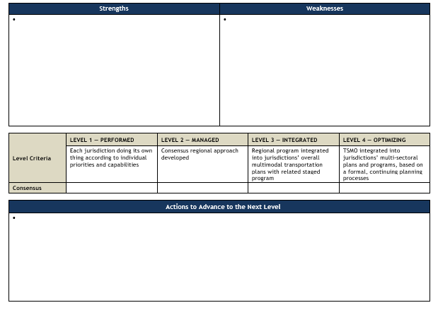
Work Session - Example Template

Slide 13
Maturity Levels

Slide 14
Poll Question
Question 1: For Work Zone Management / Planned Special Events / Road Weather Management programs the region is working well in these ways:
Question 2: For Work Zone Management / Planned Special Events / Road Weather Management programs the region is challenged with or could do better with:

Slide 15
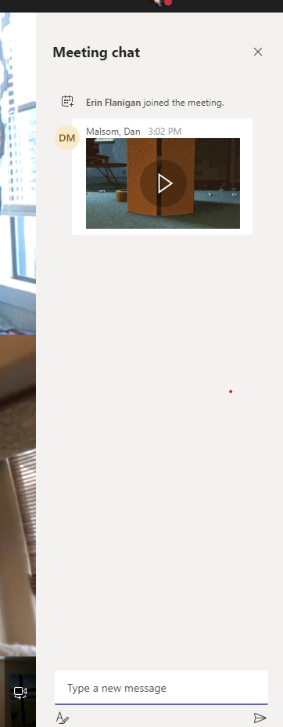
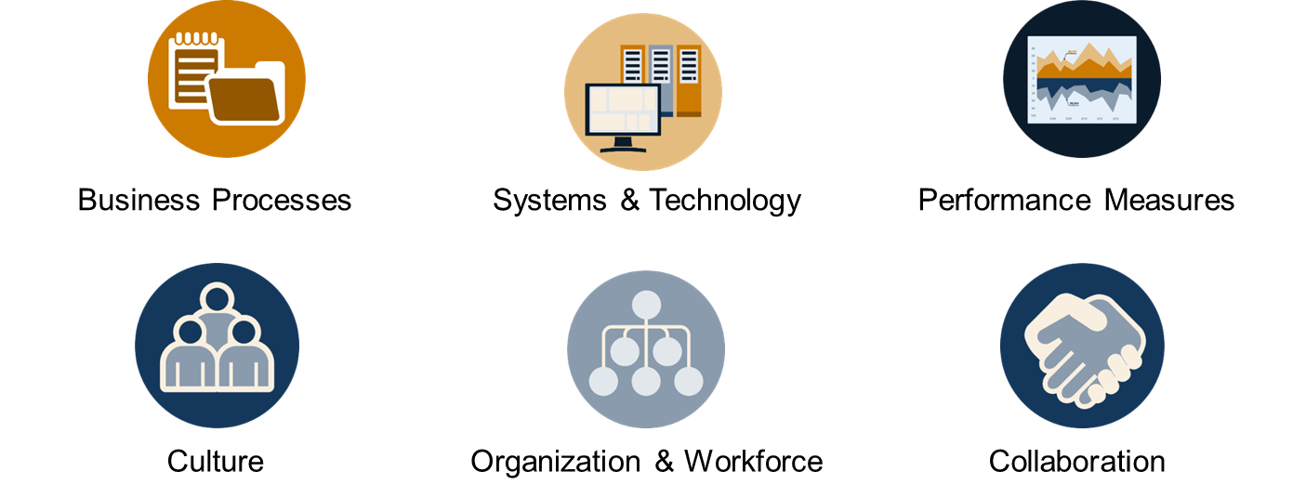
Please tell us what works well with WZ/PSE/RW management programs in the region:
Using the chat box please input a few things that go well in WZ/PSE/RW management in the region.
Associate each input with a dimension (if you can)
Shared CAD in Smithville (collaboration)
Notes:
3 minutes

Slide 16
Capability Maturity Framework – What works well?
Work Zone Management
  How do TxDOT and partner agencies alert one another to planned and upcoming closures?
  How does law enforcement collaborate or assist with work zone management activities?
  How does TxDOT incorporate other stakeholders (general public, schools, businesses, EMS, etc.) into work zone management processes?
Planned Special Event (PSE) Management
  Are transportation operations for PSEs understood as important and integrated into the culture of all regional operating entities?
Road Weather Management
  How integrated are road weather management activities?
  What is the level of availability of road weather information through existing systems and technologies?

Slide 17
Discussion
Unmute your phone – conference call style, who would like to add something to the chat inputs we are seeing?
.
.
.
.
.
.
.
Thank you! Please re-mute your phone.

Slide 18
Please tell us a few areas where WZ/PSE/RW management programs in the region could improve:
Using the chat box please input a few things areas for improvement in WZ/PSE/RW management in the region.
Associate each input with a dimension (if you can)
Limited “move over” laws (BizProcesses)
Notes:
3 minutes

Slide 19
Capability Maturity Framework – Challenges and Weaknesses
Work Zone Management
  How does TxDOT plan for and involve its partners when developing work zone plans?
  How does TxDOT coordinate and partner with local agencies when there are simultaneous ongoing projects along a corridor or within a region?
  How is institutional work zone management knowledge in various parts of TxDOT captured and shared?
Planned Special Event (PSE) Management
  Are mechanisms in place to assess and address needs, and proactively plan for events?
  Is PSE transportation and related event data captured (via TMCs, transit systems, venues, etc.), and are the data shared with other entities for real-time operational purposes?
Road Weather Management
  How does TxDOT report road weather performance to the public?
  How willing is TxDOT and its partner agencies to make decisions based on proactive road weather management measures?
  How do Maintenance, TMC operations, and other TSMO teams coordinate to support road weather management?

Slide 20
Discussion
Unmute your phone – conference call style, who would like to add something to the chat inputs we are seeing?
.
.
.
.
.
.
.
Thank you! Please re-mute your phone.

Slide 21
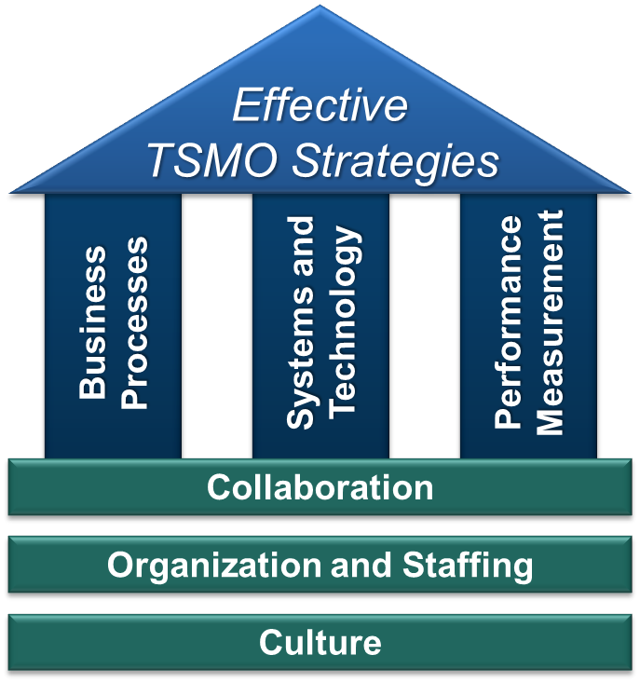
The Work Sessions
Goal for continuous improvement for those business/technical process and the institutional arrangements.
Through self-assessment identify areas in need of improvement.
Identify actions to “get to the next level” – advance operational maturity.
Output is then consensus driven key actions and inputs to the TSMO Program Plan.

Slide 22
Please tell a few actions that might “advance” the WZ/PSE/RW management programs for the region:
Using the chat box please input what actions could be suggested to improve operations for TxDOT and their partners. The actions to be identified are intended to be incremental (and doable) “next steps” to improve the region’s TSMO.
Develop outreach material for general public
Notes:
3 minutes

Slide 23
“Typical” Actions to Advance WZ/PSE/RW Management:
Formulate new, review, or renew existing partnership agreements and agree on their specificity and application.
Formalize an interjurisdictional collaboration forum, committee, or program.
Identify and apply elsewhere collaborative best practice gained from:
  existing special event management;
  a specific travel corridor or region focus;
  a specific forum, committee, or program; or
  national best practice examples
Develop local jurisdiction and law enforcement notification protocols for incidents, operational changes, etc.
Identify and develop training needs and programs internally and among partners.

Slide 24
Polling question
Which action rises to the top as one to advance?

Slide 25
Discussion
Unmute your phone – conference call style, who would like to add something to the chat inputs we are seeing?
.
.
.
.
.
.
.
Thank you! Please re-mute your phone.

Slide 26
Thank you for your time today!

Slide 27
Contacts
TxDOT – Dallas District | Kimley-Horn TSMO Team
Chris Blain christopher.blain@txdot.gov | Kent Kacir kent.kacir@kimley-horn.com
Craig Burgan craig.burgan@txdot.gov | Tom Fowler thomas.fowler@kimley-horn.com
TxDOT – Fort Worth District Theresa Poer theresa.poer@txdot.gov Kimberley Clarida kimberley.clarida@txdot.gov | Khushboo Patel khushboo.patel@kimley-horn.com Erin Flanigan, P.E., PMP eflanigan@camsys.com
Project Webpage | TxDOT TSMO Webpage
www.tsmodfw.org | www.txdot.gov/inside-txdot/division/ traffic/tsmo.html

