Slide 1

Welcome – Virtual Housekeeping Items
Transportation Systems Management and Operations (TSMO)
If you haven’t already, please type the name and the agency you represent into the chat box. This will serve as our virtual meeting sign-in sheet.
For this presentation, please make sure that you are on mute. If you have questions as we present the slides, please type them into the chat box.
During the session we will use the chat feature to get your input as well as ask you to take yourself off mute from time to time for discussion.
DFW TSMO Program Plan
Capability Maturity Model (CMM) Assessment – Traffic Signal Management/ Traffic Management
Turn CHAT on Here

Slide 2

Transportation Systems Management and Operations (TSMO)
DFW TSMO Program Plan
Capability Maturity Model (CMM) Assessment – Traffic Signal Management/ Traffic Management
August 18, 2020

Slide 3
Self Introductions

Slide 4
Table of Contents
1
CMM Webinar Objectives
5
2
TSMO Capability Maturity Model Basics
6-9
3
TSMO Topic Area Overview
10-11
4
TSMO Capability Maturity Model – Strengths, Weaknesses, Actions to Improve
12-25

Slide 5
CMM Webinar Objectives
Provide Your Inputs to the Dallas/ Fort Worth District TSMO Plan
  Step through an abbreviated CMM process on a specific TSMO strategy.
  Use the “Chat” feature to discuss strengths, weaknesses, and action to advance.
Continue the Conversation
  Discuss any questions on the TSMO strategies moving into the plan development phase of work.

Slide 6
Transportation Systems Management and Operations
  Essentially, the purpose of a TSMO Program Plan in your region is to evaluate how the existing transportation network is functioning with the aim of improving operations.

Slide 7
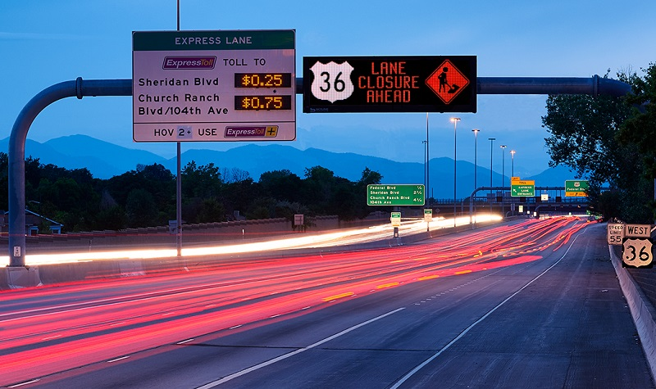
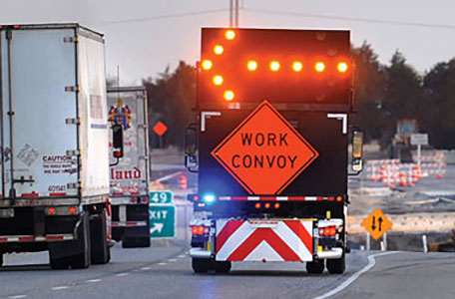

Transportation Systems Management and Operations
Traveler Information
Managed Lanes
Traffic Signal Management
Special Event Management
Road Weather Management
Freight Management
Integrated Corridor Management
Work Zone Management
Traffic Incident Management
Active Traffic Management
Notes:
This slide lists several of the operations strategies that have been applied by DOTs and transportation agencies across the country; and in doing so, they have made substantial positive impacts on the safety, mobility, and reliability of the surface transportation network.
These strategies, of which ITS and traffic signals a major part, are most effective when they are considered in early stages of the project development process, sustained over time with dedicated funding, and optimized via coordination among transportation agencies in the region.
These strategies are relatively low in cost compared with adding capacity, can be implemented in two to three years, and offer substantial benefits- for example, a benefit-cost ratio of 10:1.
Some of these strategies have already been deployed, or are currently being researched for use in various parts of the state.
Source(s): -1.) Institutional Architectures to Improve Systems Operations and Management, SHRP2 Strategic Highway Research Program, SHRP2 Reliability Research, Report S2-L06-RR-1, -2.) Investment Opportunities for Managing Transportation Performance Through Technology. Intelligent Transportation System Joint Program Office, U.S. Department of Transportation, 2009, -3.) Benefits of Using Intelligent Transportation Systems in Work Zones: A Summary Report,. FHWA,

Slide 8


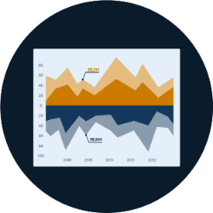



Transportation Systems Management and Operations
Capability Maturity Model
Business Processes | Systems & Technology | Performance Measures
Culture | Organization & Workforce | Collaboration
Notes:
Erin Flanigan covers this slide

Slide 9
The Dimensions of Capability Maturity
Business Processes: Operations and maintenance costs programmed? Asset management plans
Systems & Technology: Integration, interoperability issues
Performance Measurement: Data to actively manage the system
Culture: Ability for traffic managers to take risks and innovate
Organization/Workforce: workforce capabilities / training
Collaboration: Data sharing, shared control (corridor deployments)
Notes:
Business processes, including formal scoping, planning, programming, and budgeting.
TSM&O needs to be integrated into the state or regional planning process, which focuses on allocating federal and state funds within the conventional construction and maintenance programs.
Systems and technology, including systems architecture, interoperability, standardization, and documentation.
State DOT technical staff needs not only a well-developed understanding of systems and technology issues, federal guidance, but also needs to focus on standardization, upgrades, and integration, especially with the rapid rate of technology development.
Performance measurement, including measures definition, data acquisition, analysis, and utilization. Improving the effectiveness of any TSM&O strategy depends on performance measurement. Some state DOTs measure their TSM&O by the amount of activities they perform, and conduct post-event debriefings after major crashes or storms but have not yet develop the measures, analytics and reporting systems for “outputs” – systems performance in customer terms
Culture, including technical understanding, leadership, policy commitment, outreach, and program authority. Top management leadership and commitment s essential making the changes needed to support TSM&O – including making TSM&O a formal agency mission and program, staffing and other forms of support
Organization and workforce, including organizational structure, staff capacity development, and retention. TSM&O is not yet a top-level unit in most state DOT organizational structures. Its key components are often fragmented into silos—at the third or fourth level of the management hierarchy, with unclear reporting and accountability structures. Core capacity identification, training ,recruitment and retention plans are needed
Collaboration, including relationships with public safety agencies, local governments, metropolitan planning organizations (MPOs), and the private sector. Many of the important TSM&O strategies are beyond the span of control of transportation agencies alone. External collaboration – public and private – regarding procedures and protocols is essential. In some cases outsourcing may be appropriate

Slide 10
TSMO Strategy: Traffic Signal Management/ Traffic Management
Traffic signal management involves the planning, design, integration, maintenance, and proactive operation of a traffic signal system in order to achieve policy based objectives to improve the efficiency, safety, and reliability of signalized intersection operations.
Traffic Management centers are the nerve center of most freeway management systems. TMC staff use information to monitor the operation of the area’s major street and highway network. The role of a TMC often goes beyond the freeway network, functioning as the key technical and institutional hub to bring together the various jurisdictions, modal interests, and service providers to focus on the common goal of optimizing the performance of the entire surface transportation system.

Slide 11
Poll Questions
Question 1: Which dimension seems to be most “in order” for Traffic Signal and Traffic Management strategies in the DFW region?
Question 2: Which dimension seems to have the most room for improvement for Traffic Signal and Traffic Management strategies in the DFW region?
We will come back to these questions shortly

Slide 12
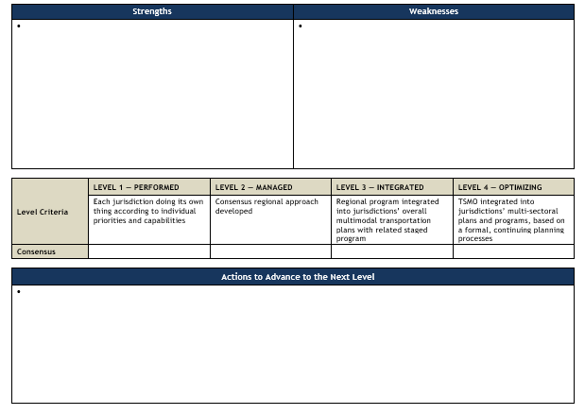
Work Session - Example Template

Slide 13
Maturity Levels

Slide 14
Poll Question
Question 1: For Traffic Signal and Traffic Management strategies in the region things works well in these ways:
Question 2: For Traffic Signal and Traffic Management strategies in the region there are challenges with, or we could do better with:

Slide 15
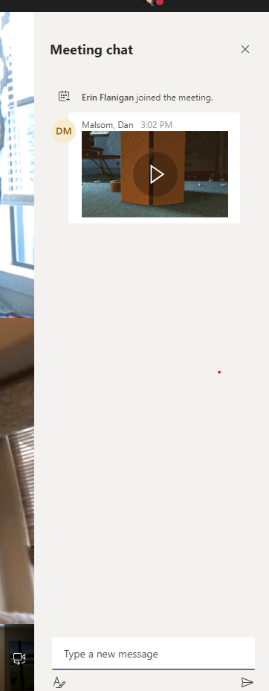
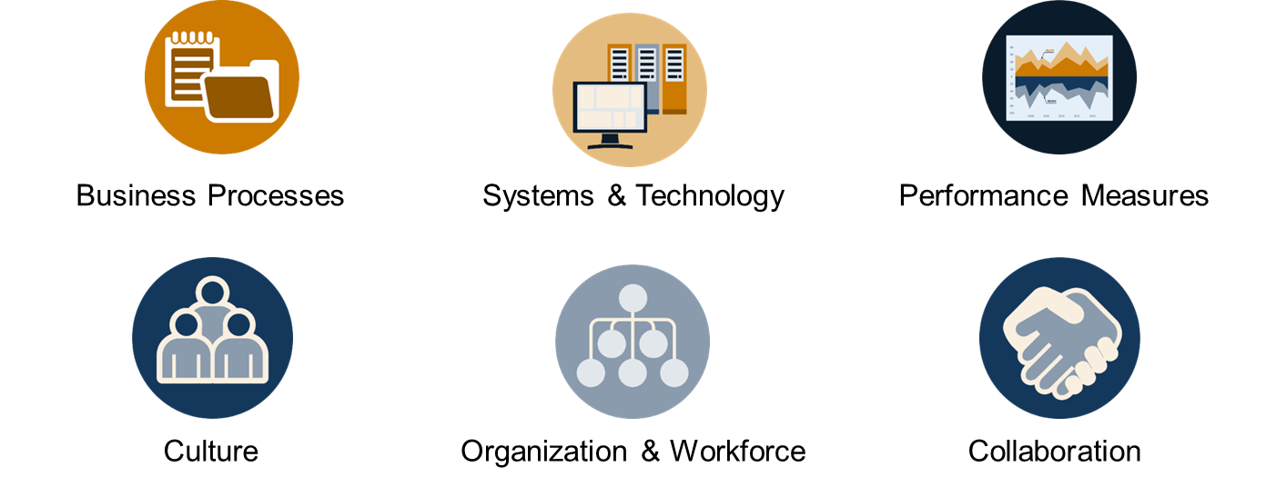
Please tell us what works well with Traffic Signal Management/ Traffic Management in the region:
Using the chat box please input a few things that go well in Traffic Signal Management/ Traffic Management in the region.
Associate each input with a dimension (if you can)
Shared CAD in Smithville (collaboration)
Notes:
3 minutes

Slide 16
Capability Maturity Framework – What works well?
How does TxDOT involve or support local agencies in signal planning and maintenance processes?
How does TxDOT respond or support response when there is an issue with a traffic signal?
How does TxDOT respond to public input or agency stakeholder input regarding traffic signals?
How can performance of traffic operations and signalized intersections be improved locally or throughout the District?
What data or information on local traffic signals would partners find useful for TxDOT to share?

Slide 17
Discussion
Unmute your phone – conference call style, who would like to add something to the chat inputs we are seeing?
.
.
.
.
.
.
.
Thank you! Please re-mute your phone.

Slide 18
Please tell us a few areas where Traffic Signal Management/ Traffic Management in the region could improve:
Using the chat box please input a few things areas for improvement in Traffic Signal Management/ Traffic Management in the region.
Associate each input with a dimension (if you can)
Limited “move over” laws (BizProcesses)
Notes:
3 minutes

Slide 19
Capability Maturity Framework – Challenges and Weaknesses
How do staff in agencies throughout the region exchange information to share what’s working well or discuss common challenges?
How do agencies partner with the private sector to address traffic management challenges?
How do agencies communicate traffic information to the public?
How does TxDOT assess and adopt new technologies?
How does TxDOT utilize ITS regional architectures and/or the systems engineering process for traffic-management-related projects?
How well does TxDOT interact with public information, with respect to traffic management?

Slide 20
Discussion
Unmute your phone – conference call style, who would like to add something to the chat inputs we are seeing?
.
.
.
.
.
.
.
Thank you! Please re-mute your phone.

Slide 21
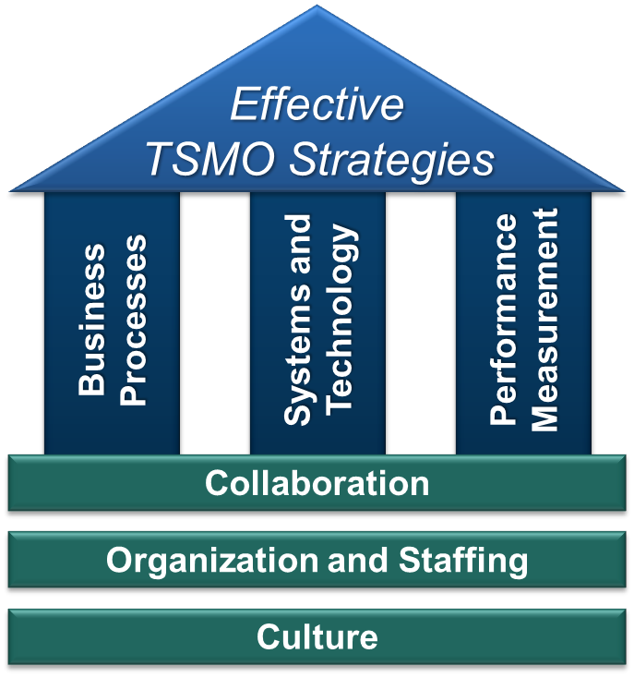
The Work Sessions
Goal for continuous improvement for those business/technical process and the institutional arrangements.
Through self-assessment identify areas in need of improvement.
Identify actions to “get to the next level” – advance operational maturity.
Output is then consensus driven key actions and inputs to the TSMO Program Plan.

Slide 22
Please tell a few actions that might “advance” the Traffic Signal Management/ Traffic Management activities in the region:
Using the chat box please input what actions could be suggested to improve operations for TxDOT and their partners. The actions to be identified are intended to be incremental (and doable) “next steps” to improve the region’s TSMO.
Develop outreach material for general public
Notes:
3 minutes

Slide 23
“Typical” Actions to Advance Traffic Signal Management/ Traffic Management:
Ensure inclusion and specificity for ITS/operations options at all stages of project development.
Document formal roles and responsibilities for signal operations between jurisdictions/ owners.
Establish/formalize a data-sharing platform and protocols.
Identify and document where formal agreements are needed.
Integrate interoperability/communication standards into the systems engineering process.
Integrate ITS device/systems maintenance into the systems engineering process.
Identify and develop training needs and programs internally and among partners.

Slide 24
Polling question
Which action rises to the top as one to advance?

Slide 25
Discussion
Unmute your phone – conference call style, who would like to add something to the chat inputs we are seeing?
.
.
.
.
.
.
.
Thank you! Please re-mute your phone.

Slide 26
Thank you for your time today!

Slide 27
Contacts
TxDOT – Dallas District | Kimley-Horn TSMO Team
Chris Blain christopher.blain@txdot.gov | Kent Kacir kent.kacir@kimley-horn.com
Craig Burgan craig.burgan@txdot.gov | Tom Fowler thomas.fowler@kimley-horn.com
TxDOT – Fort Worth District Theresa Poer theresa.poer@txdot.gov Kimberley Clarida kimberley.clarida@txdot.gov | Khushboo Patel khushboo.patel@kimley-horn.com Erin Flanigan, P.E., PMP eflanigan@camsys.com
Project Webpage | TxDOT TSMO Webpage
www.tsmodfw.org | www.txdot.gov/inside-txdot/division/ traffic/tsmo.html

