Slide 1

Virtual Meeting Housekeeping Items
If you haven’t already, please type the name and the agency you represent into the chat box. This will serve as our virtual meeting sign-in sheet.
For this presentation, please make sure that you are on mute. If you have questions as we present the slides, please type them into the chat box.
During the session we will use the chat feature to get your inputs and allow time for discussion:
Turn CHAT on here

Slide 2
Self Introductions
TxDOT – Dallas District
TxDOT – Fort Worth District
TxDOT – Division
FHWA
NCTCOG
Cities – Transportation
Cities – Public Safety
Counties
Research

Slide 3

Transportation Systems Management and Operations (TSMO)
DFW TSMO Program Plan
Capability Maturity Model (CMM) Assessment – Traffic Incident Management
August 6, 2020

Slide 4
Table of Contents
1
CMM Webinar Objectives
4
2
TSMO Capability Maturity Model Basics
5-7
3
TSMO Topic Area Overview
8-10
4
TSMO Capability Maturity Model – Strengths, Weaknesses, Actions to Improve
11-23

Slide 5
CMM Webinar Objectives
Provide Your Inputs to the Dallas/ Fort Worth District TSMO Plan
  Step through an abbreviated CMM process on a specific TSMO strategy.
  Use the “Chat” feature to discuss strengths, weaknesses, and action to advance.
Continue the conversation
  Discuss any questions on the TSMO strategies moving into the plan development phase of work.

Slide 6
Transportation Systems Management and Operations
  Essentially, the purpose of a TSMO Program Plan in your region is to evaluate how the existing transportation network is functioning with the aim of improving operations.

Slide 7
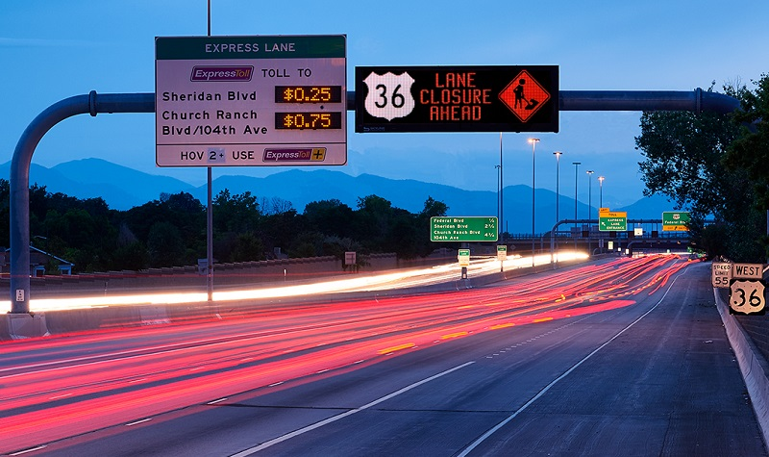
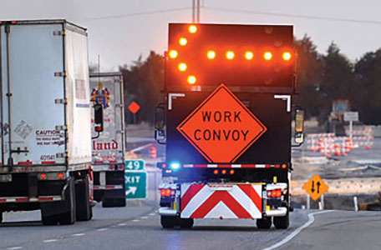

Transportation Systems Management and Operations
Traveler Information
Managed Lanes
Traffic Signal Management
Special Event Management
Road Weather Management
Freight Management
Integrated Corridor Management
Work Zone Management
Active Traffic Management
Traffic Incident Management
Notes:
This slide lists several of the operations strategies that have been applied by DOTs and transportation agencies across the country; and in doing so, they have made substantial positive impacts on the safety, mobility, and reliability of the surface transportation network.
These strategies, of which ITS and traffic signals a major part, are most effective when they are considered in early stages of the project development process, sustained over time with dedicated funding, and optimized via coordination among transportation agencies in the region.
These strategies are relatively low in cost compared with adding capacity, can be implemented in two to three years, and offer substantial benefits- for example, a benefit-cost ratio of 10:1.
Some of these strategies have already been deployed, or are currently being researched for use in various parts of the state.
Source(s): -1.) Institutional Architectures to Improve Systems Operations and Management, SHRP2 Strategic Highway Research Program, SHRP2 Reliability Research, Report S2-L06-RR-1, -2.) Investment Opportunities for Managing Transportation Performance Through Technology. Intelligent Transportation System Joint Program Office, U.S. Department of Transportation, 2009, -3.) Benefits of Using Intelligent Transportation Systems in Work Zones: A Summary Report,. FHWA,

Slide 8


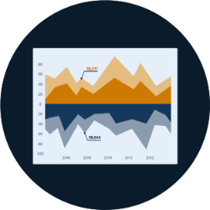



Transportation Systems Management and Operations
Capability Maturity Model
Business Processes | Systems & Technology | Performance Measures
Culture | Organization & Workforce | Collaboration
Notes:
Erin Flanigan covers this slide

Slide 9
The Dimensions of Capability Maturity
Business Processes: Planning, programming, budgeting, implementation
Systems & Technology: Systems engineering, standards, documentation
Performance Measurement: Measures, data & analytics, utilization
Culture: Technical understanding, leadership, outreach, authority
Organization/Workforce: Organization structure/ workforce capabilities
Collaboration: Partnerships - public and private
Notes:
Business processes, including formal scoping, planning, programming, and budgeting.
TSM&O needs to be integrated into the state or regional planning process, which focuses on allocating federal and state funds within the conventional construction and maintenance programs.
Systems and technology, including systems architecture, interoperability, standardization, and documentation.
State DOT technical staff needs not only a well-developed understanding of systems and technology issues, federal guidance, but also needs to focus on standardization, upgrades, and integration, especially with the rapid rate of technology development.
Performance measurement, including measures definition, data acquisition, analysis, and utilization. Improving the effectiveness of any TSM&O strategy depends on performance measurement. Some state DOTs measure their TSM&O by the amount of activities they perform, and conduct post-event debriefings after major crashes or storms but have not yet develop the measures, analytics and reporting systems for “outputs” – systems performance in customer terms
Culture, including technical understanding, leadership, policy commitment, outreach, and program authority. Top management leadership and commitment s essential making the changes needed to support TSM&O – including making TSM&O a formal agency mission and program, staffing and other forms of support
Organization and workforce, including organizational structure, staff capacity development, and retention. TSM&O is not yet a top-level unit in most state DOT organizational structures. Its key components are often fragmented into silos—at the third or fourth level of the management hierarchy, with unclear reporting and accountability structures. Core capacity identification, training ,recruitment and retention plans are needed
Collaboration, including relationships with public safety agencies, local governments, metropolitan planning organizations (MPOs), and the private sector. Many of the important TSM&O strategies are beyond the span of control of transportation agencies alone. External collaboration – public and private – regarding procedures and protocols is essential. In some cases outsourcing may be appropriate

Slide 10
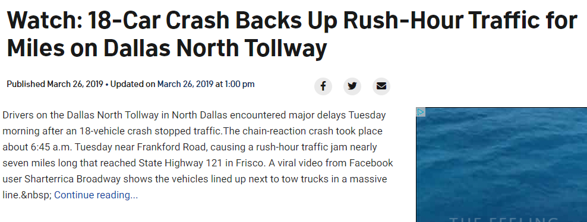
TSMO Strategy: Traffic Incident Management
Traffic incident management (TIM) consists of a planned and coordinated multi-disciplinary process to detect, respond to, and clear traffic incidents and restore traffic flow as safely and quickly as possible. Applied effectively, TIM reduces the duration and impacts of traffic incidents and improves the safety of motorists, crash victims and emergency responders.
Participants: DOT, MPOs, local agencies, first responders, police, fire, highway patrol, tow companies

Slide 11
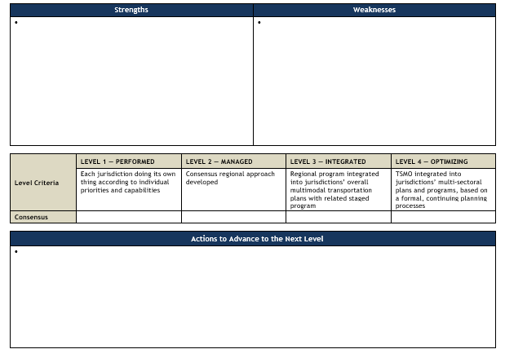
Work Session - Example Template

Slide 12
Maturity Levels

Slide 13
Poll Question
Question 1: Which dimension seems to be most “in order” for Traffic Incident Management strategies in the DFW region?
Question 2: Which dimension seems to have the most room for improvement for Traffic Incident Management strategies in the region?

Slide 14
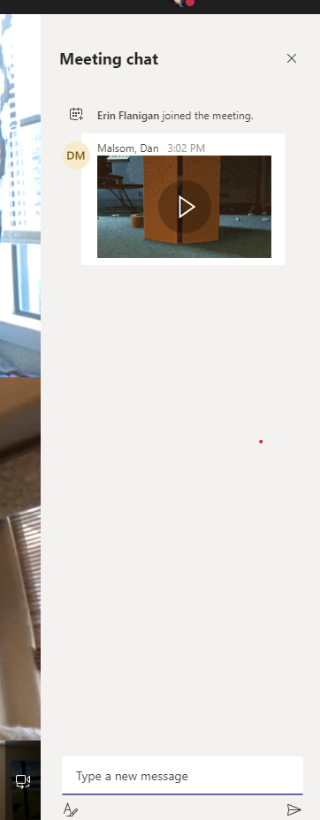
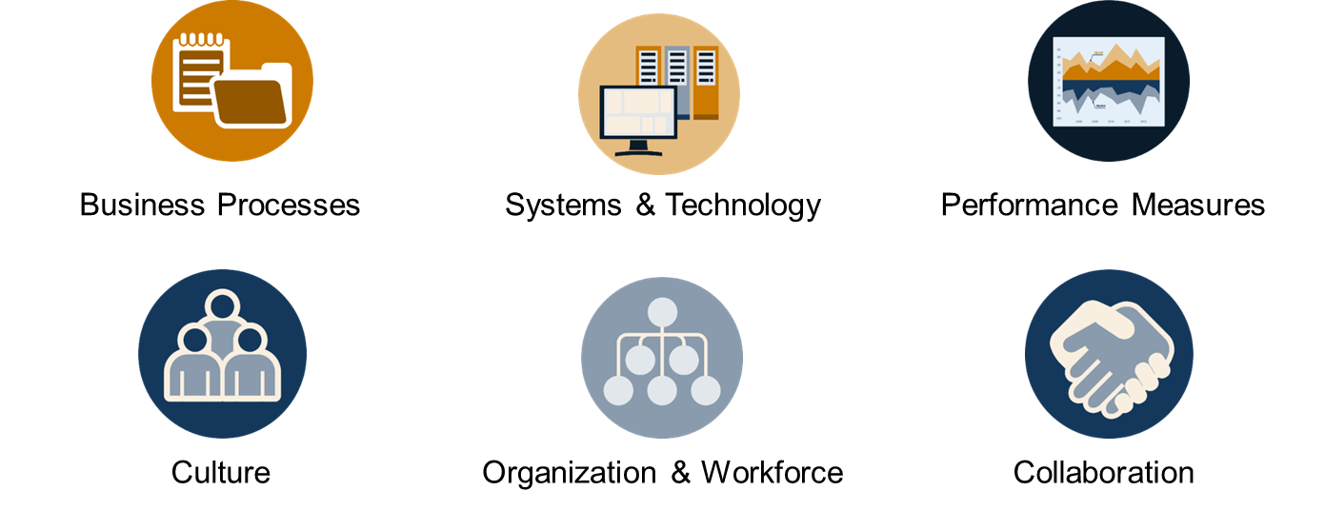
Please tell us what works well with TIM programs in the region:
Using the chat box please input a few things that go well in Traffic Incident Management in the region.
Associate each input with a dimension (if you can)
Shared CAD in Smithville (collaboration)
Notes:
3 minutes

Slide 15
Traffic Incident Management Capability Maturity Framework
Is there a formal Traffic Incident Management (TIM) program that is supported by a multidisciplinary, multiagency team or task force, which meets regularly to discuss and plan for TIM activities?
Is agency leadership actively involved in program-level TIM decisions (i.e., policy establishment, training, funding, legislation, etc.)?
Is an Authority Removal Law in place and understood by TIM stakeholders?
What outreach activities are in place to educate the public and elected officials about TIM?
Is Roadway Clearance Time (RCT) being measured? Other data collected and measured?

Slide 16
Discussion
Unmute your phone – conference call style, who would like to add something to the chat inputs we are seeing?
.
.
.
.
.
.
.
Thank you! Please re-mute your phone.

Slide 17
Please tell us a few areas where TIM programs in the region could improve:
Using the chat box please input a few things areas for improvement in Traffic Incident Management in the region.
Associate each input with a dimension (if you can)
Limited “move over” laws (BizProcesses)
Notes:
3 minutes

Slide 18
Traffic Incident Management Capability Maturity Framework
Is there a Safety Service Patrol program in place for incident and emergency response?
Have stakeholders in the region participated in a second Strategic Highway Research Program (SHRP2) National TIM Responder Training Program, or equivalent Train-the-Trainer (TtT) sessions and are they actively training others?
Are all disciplines and agencies participating in ongoing TIM enhancement activities/efforts?
Is the importance of TIM understood by all TIM stakeholders and supported by multidisciplinary, multi-agency agreements or memorandums of understanding (MOUs)?

Slide 19
Discussion
Unmute your phone – conference call style, who would like to add something to the chat inputs we are seeing?
.
.
.
.
.
.
.
Thank you! Please re-mute your phone.

Slide 20
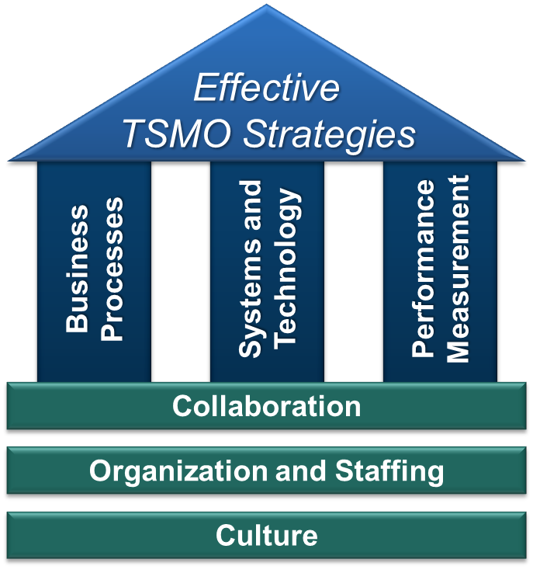
The Work Sessions
Goal for continuous improvement for those business/technical process and the institutional arrangements.
Through self-assessment identify areas in need of improvement.
Identify actions to “get to the next level” – advance operational maturity.
Output is then consensus driven key actions and inputs to the TSMO Program Plan.

Slide 21
Please tell a few actions that might “advance” the TIM program for the region:
Using the chat box please input what actions could be suggested to improve operations for TxDOT and their partners. The actions to be identified are intended to be incremental (and doable) “next steps” to improve the region’s TSMO.
Develop outreach material for general public
Notes:
3 minutes

Slide 22
“Typical” Actions to Advance TIM
Convene or utilize a TIM working group/planning committee.
Develop local jurisdiction and law enforcement notification protocols for incidents, operational changes, etc.
Incorporate the use of performance data and cost-benefit outcomes in formulating budget requests for TIM programs.
Develop arterial IM plans, procedures, and protocols; potentially include as an agenda item at incident management meetings
Establish common terminology, definitions, and measures to advance TIM programs.
Identify and develop training needs and programs internally and among partners.

Slide 23
Polling question
Which action rises to the top as one to advance?

Slide 24
Discussion
Unmute your phone – conference call style, who would like to add something to the chat inputs we are seeing?
.
.
.
.
.
.
.
Thank you! Please re-mute your phone.

Slide 25
Thank you for your time today!

Slide 26
Contacts
TxDOT – Dallas District | Kimley-Horn TSMO Team
Chris Blain christopher.blain@txdot.gov | Kent Kacir kent.kacir@kimley-horn.com
Craig Burgan craig.burgan@txdot.gov | Tom Fowler thomas.fowler@kimley-horn.com
TxDOT – Fort Worth District Theresa Poer theresa.poer@txdot.gov Kimberley Clarida kimberley.clarida@txdot.gov | Khushboo Patel khushboo.patel@kimley-horn.com Erin Flanigan, P.E., PMP eflanigan@camsys.com
Project Webpage | TxDOT TSMO Webpage
www.tsmodfw.org | www.txdot.gov/inside-txdot/division/ traffic/tsmo.html

